Slide 1


Michael Maimoni
Joana Sean

Slide 2
CONTEXT
Utilize ETL methods to obtain and prepare data for use in downstream visualizations, enabling multiple custom visualizations of U.S. wage data by state / occupation.
Categories of Interest: Average hourly wage by state; average hourly wage for each occupation by state
Coding Approach: HTML/CSS with JavaScript and Masonry JS/D3.JS
Data Munging: Python (Pandas, etc.), MS Excel
Data Source: Bureau of Labor Statistics, CSV to JSON within MongoDB served via Flask RESTful API.
Key Challenges

Slide 3
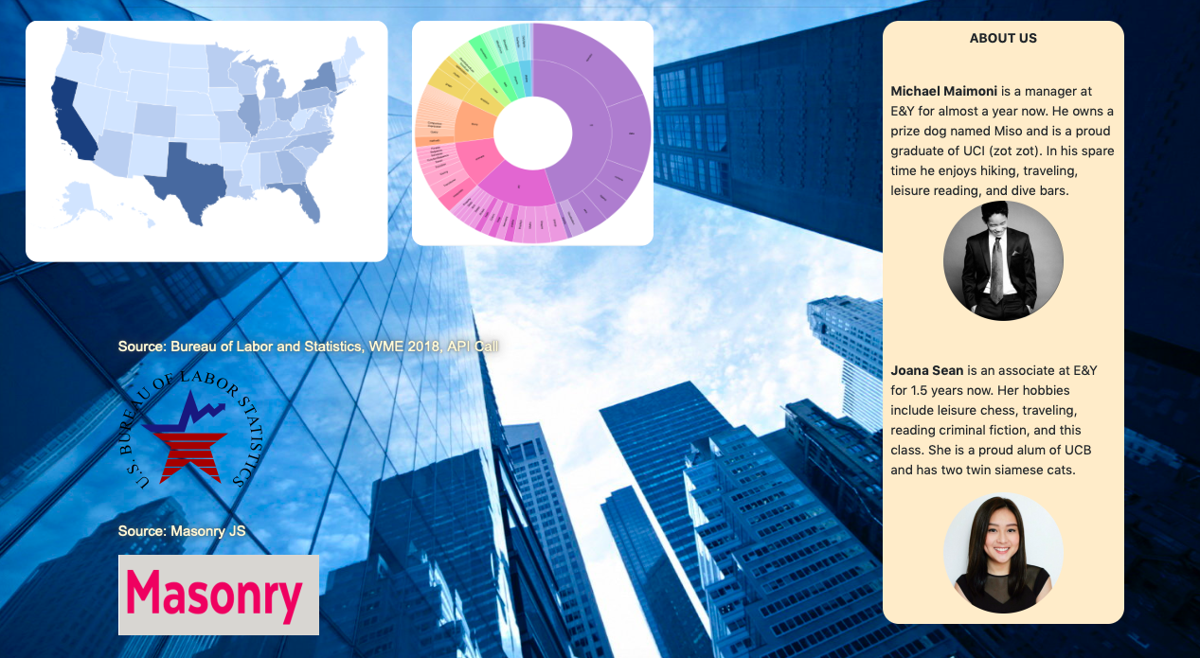
The Landing Page

Slide 4
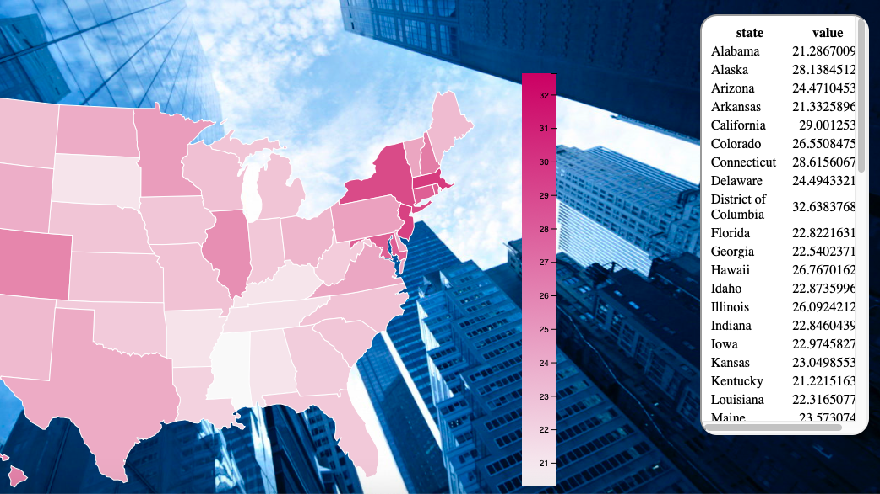
Figure 1 – US Choropleth

Slide 5
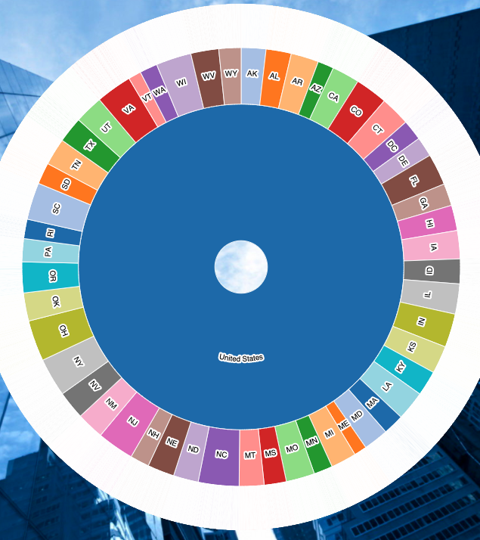
Figure 2 – Zoomable Sunburst

Slide 6
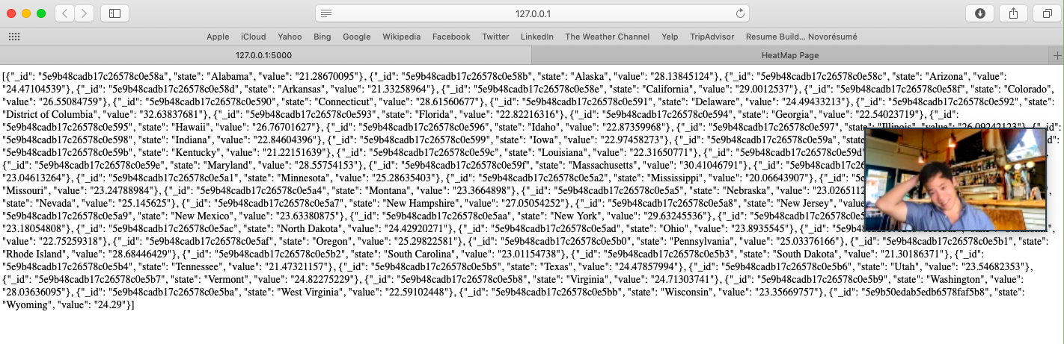
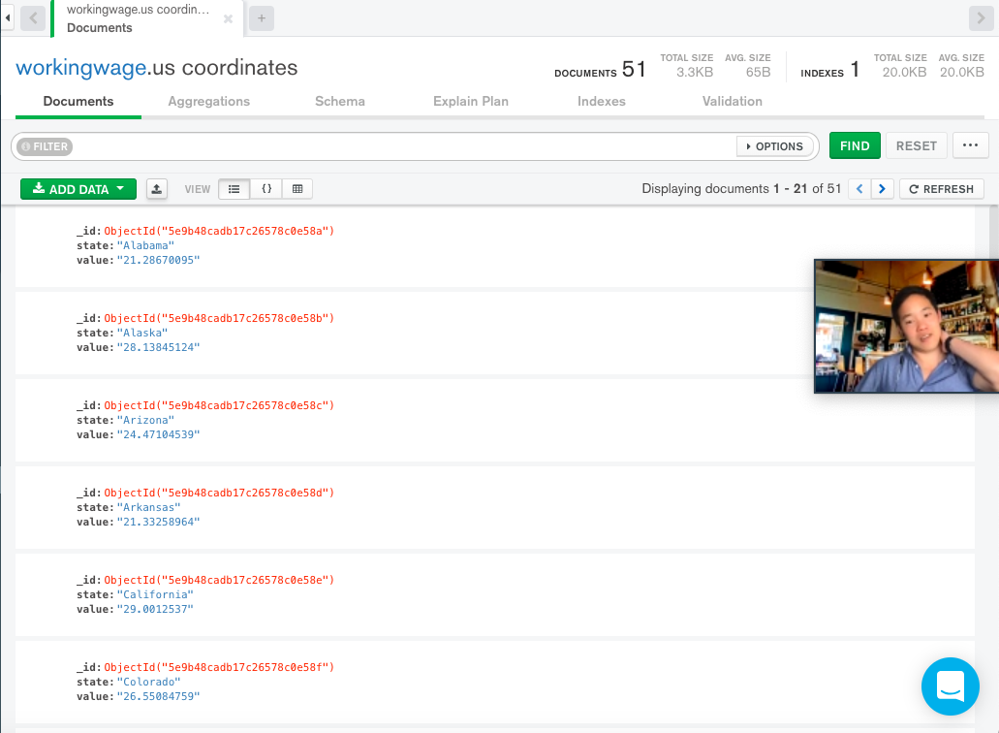
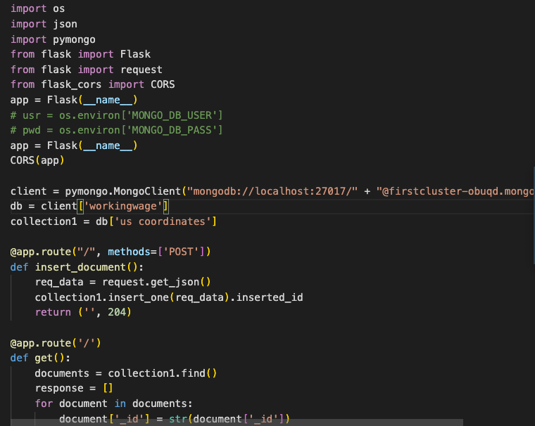
Mongo DB
Flask RESTful API

Slide 7


Key Challenges
Build to Hierarchy
Masonry JS
“Challenges are what make life interesting and overcoming them is what makes life meaningful.”
Overall Assessment
Next steps, we would host our data and run the visual from AWS.

